Slide 1
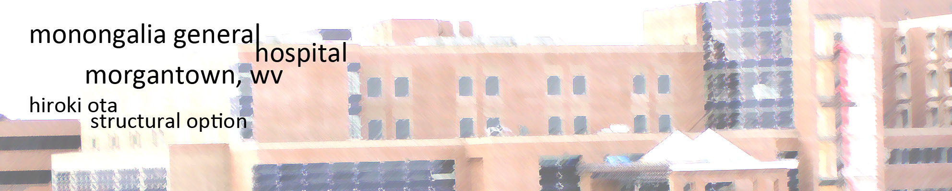

Slide 2

topics
existing conditions
BUILDING STATISTICS
depth
BLAST AND PROGRESSIVE COLLAPSE ANALYSIS
breadth
COST AND SCHEDULE ANALYSIS
BLAST AND CONDUCTIVITY ANALYSIS OF CURTAIN WALLS
conclusion
HIROKI OTA
AE 482
01
TOPICS
05
CONCLUSION
A
MATRIX
E
02
CONDITIONS
06
LEED
monongalia general hospital
B
BUBBLE
F
03
DEPTH
AREA TABLE
Last update 12 APR. 2009
07
C
STACKING
G
Copyright © Hiroki Ota 2009
BREADTH
SKETCHES
presentation ver. 2.0
04
08
D
H
architectural engineering department

Slide 3
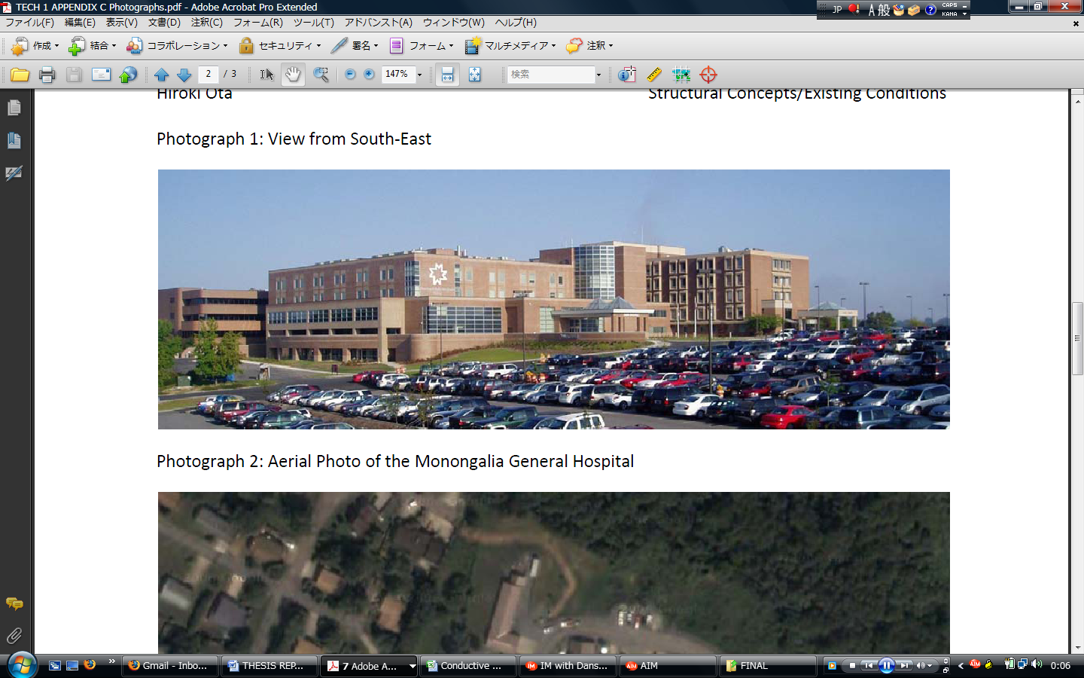
existing conditions
view from the south east
source: turner construction company
HIROKI OTA
AE 482
01
TOPICS
05
CONCLUSION
A
architecture
E
construction
02
CONDITIONS
06
LEED
monongalia general hospital
B
structure
F
03
DEPTH
AREA TABLE
Last update 12 APR. 2009
07
C
l & e
G
Copyright © Hiroki Ota 2009
BREADTH
mechanical
presentation ver. 2.0
04
08
D
H
architectural engineering department

Slide 4
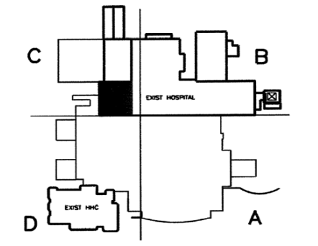
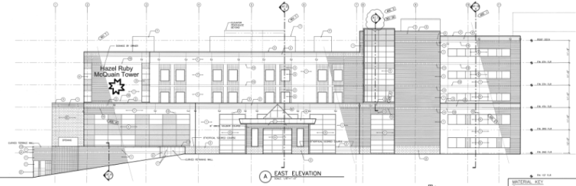
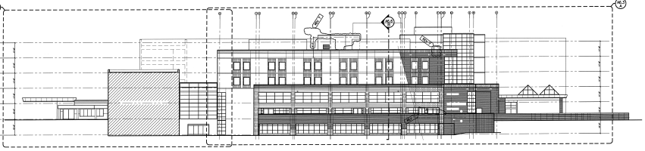
existing conditions
ARCHITECTURE
six story general hospital – 340,000 square feet
houses multiple hospital functions
flat roof – ballasted and adhered
masonry and curtain wall façade
east elevation
south elevation
HIROKI OTA
AE 482
01
TOPICS
05
CONCLUSION
A
architecture
E
construction
02
CONDITIONS
06
LEED
monongalia general hospital
B
structure
F
03
DEPTH
AREA TABLE
Last update 12 APR. 2009
07
C
l & e
G
Copyright © Hiroki Ota 2009
BREADTH
mechanical
presentation ver. 2.0
04
08
D
H
architectural engineering department

Slide 5
existing conditions
STRUCTURE
combination of concrete moment frame and shear walls
spread footing foundations >10’ below grade
(100) 24” x 24” columns
typical bay is 27’ x 27’
two way flat slab
ground floor plan
HIROKI OTA
AE 482
01
TOPICS
05
CONCLUSION
A
architecture
E
construction
02
CONDITIONS
06
LEED
monongalia general hospital
B
structure
F
03
DEPTH
AREA TABLE
Last update 12 APR. 2009
07
C
l & e
G
Copyright © Hiroki Ota 2009
BREADTH
mechanical
presentation ver. 2.0
04
08
D
H
architectural engineering department

Slide 6
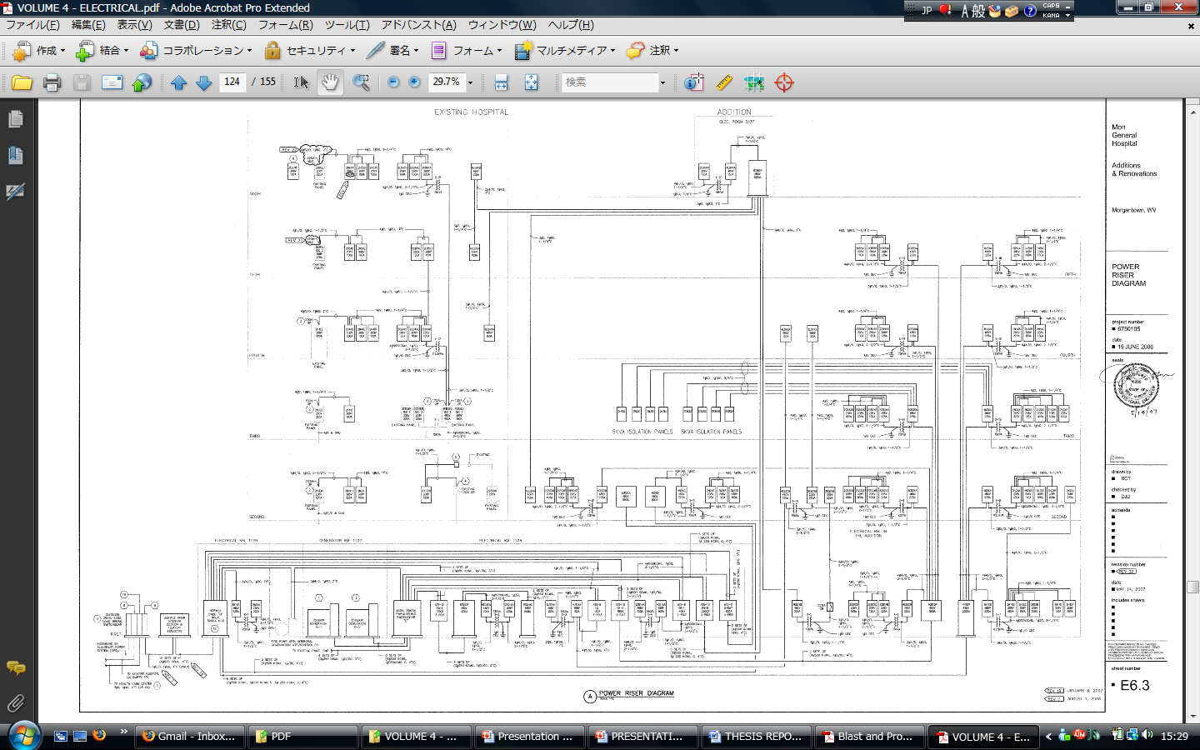
existing conditions
LIGHTING AND ELECTRICAL
utilizes 480/277V 3Φ 4 wire and 208/120V 3Φ 4 wire system
all mechanical and medical equipment linked to 480/277V
lighting fixtures linked to 208/120V with electronic type ballasts at 95% PF
time switches provided for all exterior lighting
two 1500kW diesel engine generators
power riser diagram
HIROKI OTA
AE 482
01
TOPICS
05
CONCLUSION
A
architecture
E
construction
02
CONDITIONS
06
LEED
monongalia general hospital
B
structure
F
03
DEPTH
AREA TABLE
Last update 12 APR. 2009
07
C
l & e
G
Copyright © Hiroki Ota 2009
BREADTH
mechanical
presentation ver. 2.0
04
08
D
H
architectural engineering department

Slide 7
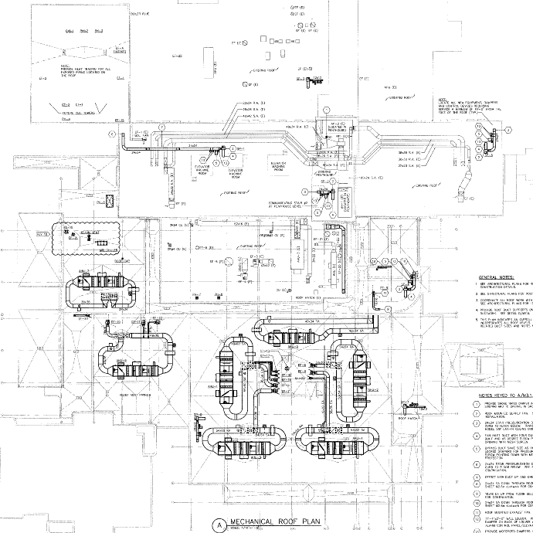
existing conditions
MECHANICAL
seven rooftop VAV-AHU
water-cooled chiller, cooling tower, and steam boiler are also located on the rooftop
hot and cold water provided to all toilets, examination and operation rooms, and kitchen
electrical duct heating provided in all rooms and hallways
mechanical systems connected to generators
mechanical roof plan
HIROKI OTA
AE 482
01
TOPICS
05
CONCLUSION
A
architecture
E
construction
02
CONDITIONS
06
LEED
monongalia general hospital
B
structure
F
03
DEPTH
AREA TABLE
Last update 12 APR. 2009
07
C
l & e
G
Copyright © Hiroki Ota 2009
BREADTH
mechanical
presentation ver. 2.0
04
08
D
H
architectural engineering department

Slide 8
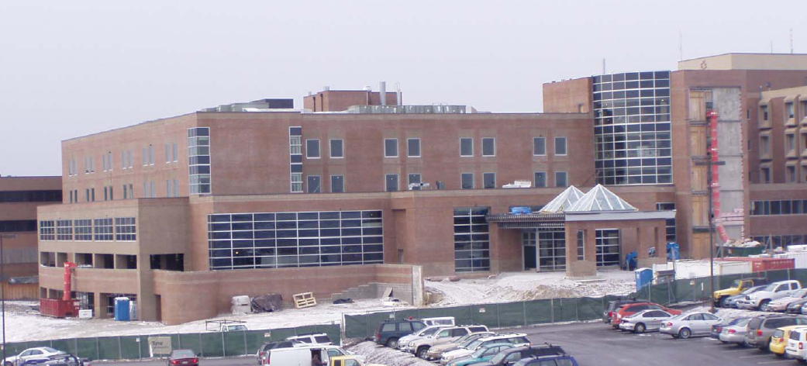
existing conditions
CONSTRUCTION
december 2005 – july 2008
design-build
guaranteed maximum price set at $68,000,000 by the Turner Construction Company
ground broken with 70% completion of construction documents
source: turner construction company
HIROKI OTA
AE 482
01
TOPICS
05
CONCLUSION
A
architecture
E
construction
02
CONDITIONS
06
LEED
monongalia general hospital
B
structure
F
03
DEPTH
AREA TABLE
Last update 12 APR. 2009
07
C
l & e
G
Copyright © Hiroki Ota 2009
BREADTH
mechanical
presentation ver. 2.0
04
08
D
H
architectural engineering department

Slide 9
depth
BLAST AND PROGRESSIVE COLLAPSE ANALYSIS
to incorporate blast and collapse resistant design to mitigate catastrophic scenarios in the event of a terrorist attack
HIROKI OTA
AE 482
01
TOPICS
05
CONCLUSION
A
blast
E
direct
02
CONDITIONS
06
LEED
monongalia general hospital
B
collapse
F
03
DEPTH
AREA TABLE
Last update 12 APR. 2009
07
C
design
G
Copyright © Hiroki Ota 2009
BREADTH
indirect
presentation ver. 2.0
04
08
D
H
architectural engineering department

Slide 10
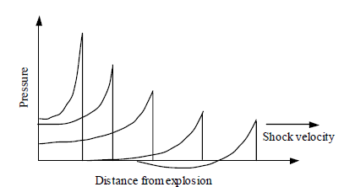
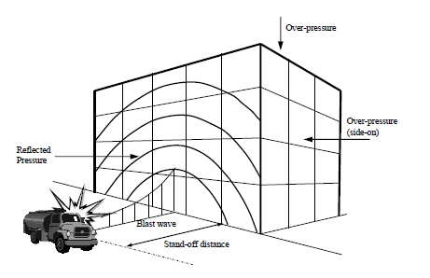
depth
BLAST ANALYSIS
blast loads are directly proportional to the stress wave propagation resulting in a dynamic loading situation on the structure
open-air and confined blast
building is engulfed by the shockwave, creates complex loading pattern around the structure
HIROKI OTA
AE 482
01
TOPICS
05
CONCLUSION
A
blast
E
direct
02
CONDITIONS
06
LEED
monongalia general hospital
B
collapse
F
03
DEPTH
AREA TABLE
Last update 12 APR. 2009
07
C
design
G
Copyright © Hiroki Ota 2009
BREADTH
indirect
presentation ver. 2.0
04
08
D
H
architectural engineering department

Slide 11
depth
BLAST ANALYSIS
confined blasts are extremely hard to analyze – fluid dynamics and solid dynamics
blast is assumed to have eliminated a column
open-air blast will be analyzed in the breadth section
HIROKI OTA
AE 482
01
TOPICS
05
CONCLUSION
A
blast
E
direct
02
CONDITIONS
06
LEED
monongalia general hospital
B
collapse
F
03
DEPTH
AREA TABLE
Last update 12 APR. 2009
07
C
design
G
Copyright © Hiroki Ota 2009
BREADTH
indirect
presentation ver. 2.0
04
08
D
H
architectural engineering department

Slide 12
depth
PROGRESSIVE COLLAPSE ANALYSIS
collapse is caused by “the spread of an initial local failure from element to element, eventually resulting in the collapse of an entire structure or a disproportionately large part of it.”
blast is assumed to have eliminated a column, triggering a collapse scenario
HIROKI OTA
AE 482
01
TOPICS
05
CONCLUSION
A
blast
E
direct
02
CONDITIONS
06
LEED
monongalia general hospital
B
collapse
F
03
DEPTH
AREA TABLE
Last update 12 APR. 2009
07
C
design
G
Copyright © Hiroki Ota 2009
BREADTH
indirect
presentation ver. 2.0
04
08
D
H
architectural engineering department

Slide 13
depth
DESIGN
assumed to be a medium level of protection building
two methods used for design
  indirect design method
  direct design method, alternate path
indirect design to determine required steel reinforcement
direct design to determine new floor design
designs compared for effectiveness (also discussed in breadth)
HIROKI OTA
AE 482
01
TOPICS
05
CONCLUSION
A
blast
E
direct
02
CONDITIONS
06
LEED
monongalia general hospital
B
collapse
F
03
DEPTH
AREA TABLE
Last update 12 APR. 2009
07
C
design
G
Copyright © Hiroki Ota 2009
BREADTH
indirect
presentation ver. 2.0
04
08
D
H
architectural engineering department

Slide 14
depth
INDIRECT DESIGN
indirect design yielded the following results:
Tie | Tie Force (kips) | AsREQ’D (in²) | AsPROV’D (in²)
Peripheral | 9.9 | 0.176 | 0.93
Internal (E-W) | 6.02 /ft_{width} | 0.107 /ft_{width} | 1.607 /ft_{width}
Internal (N-S) | 5.31 /ft_{width} | 0.0945 /ft_{width} | 0.408 /ft_{width}
Horizontal | 14.8 | 0.263 /ft_{width} | 0.33 /ft_{width}
Vertical | 123.3 | 2.19 | 6
Corner Column | 121.3 | 2.16 | 6
existing design is adequate, but new detailing is required…
HIROKI OTA
AE 482
01
TOPICS
05
CONCLUSION
A
blast
E
direct
02
CONDITIONS
06
LEED
monongalia general hospital
B
collapse
F
03
DEPTH
AREA TABLE
Last update 12 APR. 2009
07
C
design
G
Copyright © Hiroki Ota 2009
BREADTH
indirect
presentation ver. 2.0
04
08
D
H
architectural engineering department

Slide 15
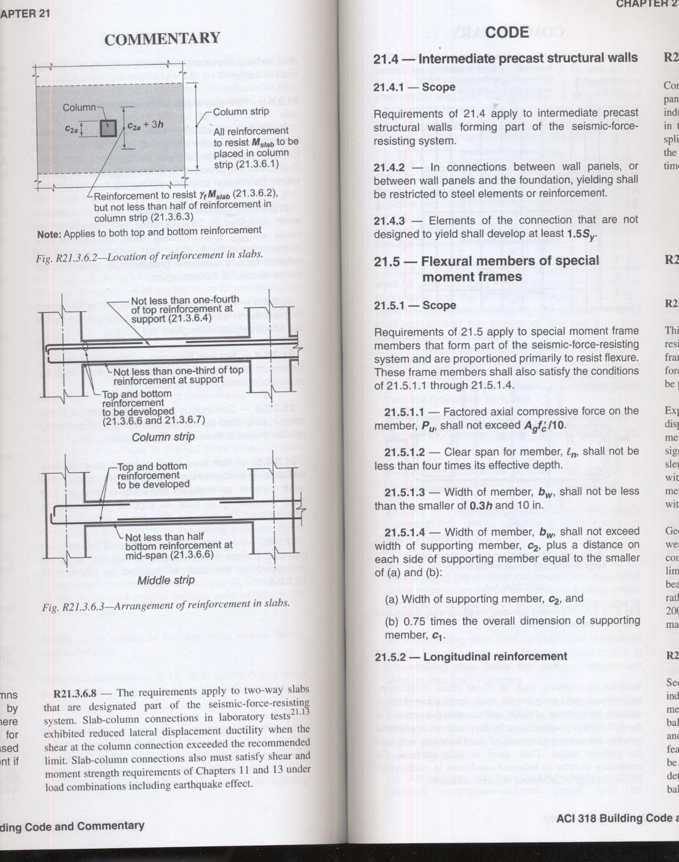
depth
INDIRECT DESIGN
additional detailing is required…
per UFC 4-023-03, reinforcements must be continuous
research by Corey, Hayes, Mehrdad, and Serkan: “seismic detailing can be compatible with collapse mitigation”
HIROKI OTA
AE 482
01
TOPICS
05
CONCLUSION
A
blast
E
direct
02
CONDITIONS
06
LEED
monongalia general hospital
B
collapse
F
03
DEPTH
AREA TABLE
Last update 12 APR. 2009
07
C
design
G
Copyright © Hiroki Ota 2009
BREADTH
indirect
presentation ver. 2.0
04
08
D
H
architectural engineering department

Slide 16
depth
INDIRECT DESIGN
additional detailing is required…
use of type 2 mechanical splices at third points of floor height
use of type 2 mechanical splices to maintain continuity on horizontal members
use of 135 degree seismic hooks at horizontal and vertical ties
HIROKI OTA
AE 482
01
TOPICS
05
CONCLUSION
A
blast
E
direct
02
CONDITIONS
06
LEED
monongalia general hospital
B
collapse
F
03
DEPTH
AREA TABLE
Last update 12 APR. 2009
07
C
design
G
Copyright © Hiroki Ota 2009
BREADTH
indirect
presentation ver. 2.0
04
08
D
H
architectural engineering department

Slide 17
depth
DIRECT DESIGN
two locations analyzed
column in the lobby removed, 54’ span
corner column removed, 30’-4” cantilever situation
existing slab analyzed
post-tensioned slab designed
HIROKI OTA
AE 482
01
TOPICS
05
CONCLUSION
A
blast
E
direct
02
CONDITIONS
06
LEED
monongalia general hospital
B
collapse
F
03
DEPTH
AREA TABLE
Last update 12 APR. 2009
07
C
design
G
Copyright © Hiroki Ota 2009
BREADTH
indirect
presentation ver. 2.0
04
08
D
H
architectural engineering department

Slide 18
depth
DIRECT DESIGN
first location, 54’ span – two way slab design:
t = 8” | f’c = 5000 psi
 | Frame A |  | Frame B
 | M⁺ | M⁻ | M⁺ | M⁻
Column Strip | (19) #5 | (33) #5 | (18) #5 | (33) #5
Middle Strip | (25) #5 | (57) #5 | (10) #5 | (25) #5
first location, 54’ span – post-tensioned slab design:
t = 10” | f’c = 5000 psi | f’ci = 3000 psi | fpu = 270 ksi
 | Reinforcement | Tendons
 | #10 @ 12” o.c. | (39) ½” Φ 7 wire
HIROKI OTA
AE 482
01
TOPICS
05
CONCLUSION
A
blast
E
direct
02
CONDITIONS
06
LEED
monongalia general hospital
B
collapse
F
03
DEPTH
AREA TABLE
Last update 12 APR. 2009
07
C
design
G
Copyright © Hiroki Ota 2009
BREADTH
indirect
presentation ver. 2.0
04
08
D
H
architectural engineering department

Slide 19
depth
DIRECT DESIGN
second location, 30’-4” cantilever – two way slab design:
t = 8” | f’c = 5000 psi
 | Frame C |  |  | Frame D
 | M⁻_{EXT} | M⁺_{INT} | M⁻_{INT} | M⁻_{EXT} | M⁺_{INT} |  | M⁻_{INT}
Column Strip | (32) #5 | (50) #5 | (61) #5 | (31) #5 | (31) #5 |  | (20) #5
Middle Strip | (10) #5 | (13) #5 | (27) #5 | (23) #5 | (27) #5 |  | (16) #5
second location, 30’-4” cantilever – post-tensioned slab design:
t = 10” | f’c = 5000 psi | f’ci = 3000 psi | fpu = 270 ksi
 | Reinforcement | Tendons
 | N/A | (30) ½” Φ 7 wire
HIROKI OTA
AE 482
01
TOPICS
05
CONCLUSION
A
blast
E
direct
02
CONDITIONS
06
LEED
monongalia general hospital
B
collapse
F
03
DEPTH
AREA TABLE
Last update 12 APR. 2009
07
C
design
G
Copyright © Hiroki Ota 2009
BREADTH
indirect
presentation ver. 2.0
04
08
D
H
architectural engineering department

Slide 20
breadth
Existing Conditions: Elevated Slab
 | Quantity | Unit Cost | Labor Cost | Equipment Cost | Total Cost
5000 psi Concrete | 5290.89 yd³ | 111.00 |  |  | $587,285.46
Placement | 5290.89 yd³ |  | 13.55 | 4.94 | $97,828.00
Reinforcing Steel | 1230 tons | 990.00 | 475.00 |  | $1,801,950.00
Formwork | 49689 ft² | 1.55 | 3.43 |  | $247,451.22
Slab Finishing | 198755 ft² |  | 0.68 |  | $135,153.40
Total |  |  |  |  | $2,869,668.08
Redesigned Conditions: Elevated Slab (Indirect Design)
 | Quantity | Unit Cost | Labor Cost | Equipment Cost | Total Cost
5000 psi Concrete | 5290.89 yd³ | 111.00 |  |  | $587,285.46
Placement | 5290.89 yd³ |  | 13.55 | 4.94 | $97,828.00
Reinforcing Steel | 1260 tons | 990.00 | 475.00 |  | $1,845,900.00
Formwork | 49689 ft² | 1.55 | 3.43 |  | $247,451.22
Slab Finishing | 198755 ft² |  | 0.68 |  | $135,153.40
Total |  |  |  |  | $2,928,268.08
Difference: Redesign - Existing |  |  |  |  | $43,950.00
COST ANALYSIS
the indirect and direct designs will be further analyzed for cost
extra 30 tons due to detailing changes
HIROKI OTA
AE 482
01
TOPICS
05
CONCLUSION
A
cost
E
direct
02
CONDITIONS
06
LEED
monongalia general hospital
B
schedule
F
03
DEPTH
AREA TABLE
Last update 12 APR. 2009
07
C
curtain wall
G
Copyright © Hiroki Ota 2009
BREADTH
indirect
presentation ver. 2.0
04
08
D
H
architectural engineering department

Slide 21
breadth
Existing Conditions: Elevated Slab
 | Quantity | Unit Cost | Labor Cost | Equipment Cost | Total Cost
5000 psi Concrete | 5290.89 yd³ | 111.00 |  |  | $587,285.46
Placement | 5290.89 yd³ |  | 13.55 | 4.94 | $97,828.00
Reinforcing Steel | 1230 tons | 990.00 | 475.00 |  | $1,801,950.00
Formwork | 49689 ft² | 1.55 | 3.43 |  | $247,451.22
Slab Finishing | 198755 ft² |  | 0.68 |  | $135,153.40
Total |  |  |  |  | $2,869,668.08
Existing Conditions: Elevated Slab (8” Thick) After Redesign (Direct Design)
 | Quantity | Unit Cost | Labor Cost | Equipment Cost | Total Cost
5000 psi Concrete | 5290.89 yd³ | 111.00 |  |  | $587,285.46
Placement | 5290.89 yd³ |  | 13.55 | 4.94 | $97,828.00
Reinforcing Steel | 5500 tons | 990.00 | 475.00 |  | $8,057,500.00
Formwork | 49689 ft² | 1.55 | 3.43 |  | $247,451.22
Slab Finishing | 198755 ft² |  | 0.68 |  | $135,153.40
Total |  |  |  |  | $9,125,218.08
Difference: Redesign - Existing |  |  |  |  | $6,255,550.00
COST ANALYSIS
two-way slab by direct design hikes the reinforcing steel cost
HIROKI OTA
AE 482
01
TOPICS
05
CONCLUSION
A
cost
E
direct
02
CONDITIONS
06
LEED
monongalia general hospital
B
schedule
F
03
DEPTH
AREA TABLE
Last update 12 APR. 2009
07
C
curtain wall
G
Copyright © Hiroki Ota 2009
BREADTH
indirect
presentation ver. 2.0
04
08
D
H
architectural engineering department

Slide 22
breadth
Existing Conditions: Elevated Slab
 | Quantity | Unit Cost | Labor Cost | Equipment Cost | Total Cost
5000 psi Concrete | 5290.89 yd³ | 111.00 |  |  | $587,285.46
Placement | 5290.89 yd³ |  | 13.55 | 4.94 | $97,828.00
Reinforcing Steel | 1230 tons | 990.00 | 475.00 |  | $1,801,950.00
Formwork | 49689 ft² | 1.55 | 3.43 |  | $247,451.22
Slab Finishing | 198755 ft² |  | 0.68 |  | $135,153.40
Total |  |  |  |  | $2,869,668.08
Redesigned Conditions: PT Slab (Direct Design)
 | Quantity | Unit Cost | Labor Cost | Equipment Cost | Total Cost
5000 psi Concrete | 6613.62 yd³ | 111.00 |  |  | $587,285.46
Placement | 6613.62 yd³ |  | 13.55 | 4.94 | $97,828.00
Reinforcing Steel | 500 tons | 990.00 | 475.00 |  | $293,000.00
Prestressing Steel | 600 tons | 1800.00 | 475.00 |  | $1,365,000.00
Formwork | 62111.3 ft² | 1.55 | 3.43 |  | $247,451.22
Slab Finishing | 198755 ft² |  | 0.68 |  | $135,153.40
Total |  |  |  |  | $2,958,864.00
Difference: Redesign - Existing |  |  |  |  | $89,195.95
COST ANALYSIS
post-tensioned slab increases the cost
HIROKI OTA
AE 482
01
TOPICS
05
CONCLUSION
A
cost
E
direct
02
CONDITIONS
06
LEED
monongalia general hospital
B
schedule
F
03
DEPTH
AREA TABLE
Last update 12 APR. 2009
07
C
curtain wall
G
Copyright © Hiroki Ota 2009
BREADTH
indirect
presentation ver. 2.0
04
08
D
H
architectural engineering department

Slide 23
breadth
COST ANALYSIS
comparison of two designs
Design Method | Major Cost Contributors | Total Cost of Construction | Difference to Existing Construction | Impact to Overall Project Cost
Indirect Design Method | Reinforcing Steel $1,801,950.00 | $2,869,668.08 | $43,950.00 | +0.077%
Direct Design Method-PT-Slab | Reinforcing Steel $293,000.00 | $2,958,864.00 | $89,195.95 | +0.156%
 | Prestressing Steel $1,365,000.00
Difference |  | $89,195.92 | $45,245.95
both designs have minimal impact on the overall project volume
the designs’ impact on the schedule will also be analyzed
HIROKI OTA
AE 482
01
TOPICS
05
CONCLUSION
A
cost
E
direct
02
CONDITIONS
06
LEED
monongalia general hospital
B
schedule
F
03
DEPTH
AREA TABLE
Last update 12 APR. 2009
07
C
curtain wall
G
Copyright © Hiroki Ota 2009
BREADTH
indirect
presentation ver. 2.0
04
08
D
H
architectural engineering department

Slide 24
breadth
SCHEDULE ANALYSIS
the schedule is broken down into three major zones
a task in one zone is completed and then the next zone’s task will commence
HIROKI OTA
AE 482
01
TOPICS
05
CONCLUSION
A
cost
E
direct
02
CONDITIONS
06
LEED
monongalia general hospital
B
schedule
F
03
DEPTH
AREA TABLE
Last update 12 APR. 2009
07
C
curtain wall
G
Copyright © Hiroki Ota 2009
BREADTH
indirect
presentation ver. 2.0
04
08
D
H
architectural engineering department

Slide 25
breadth
SCHEDULE ANALYSIS
summary of schedule change
 | Area A Work Days
Original Schedule | 137
Indirect | 138 | -
Direct | - | 165
Difference | -1 | -28
 | Area B Work Days
Original Schedule | 89
Indirect | 87 | -
Direct | - | 107
Difference | +2 | -18
post-tensioned design delays the project by 46 days
increasing the amount of reinforcement is the better choice
HIROKI OTA
AE 482
01
TOPICS
05
CONCLUSION
A
cost
E
direct
02
CONDITIONS
06
LEED
monongalia general hospital
B
schedule
F
03
DEPTH
AREA TABLE
Last update 12 APR. 2009
07
C
curtain wall
G
Copyright © Hiroki Ota 2009
BREADTH
indirect
presentation ver. 2.0
04
08
D
H
architectural engineering department

Slide 26
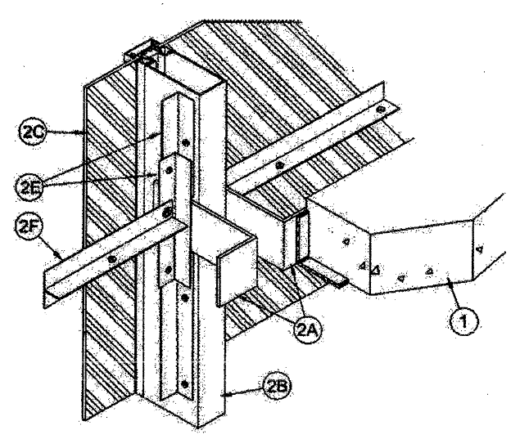
breadth
CURTAIN WALL DESIGN
the existing curtain wall will be analyzed against blast loads as per ASTM F 2248-03
two alternatives were also designed
HIROKI OTA
AE 482
01
TOPICS
05
CONCLUSION
A
cost
E
direct
02
CONDITIONS
06
LEED
monongalia general hospital
B
schedule
F
03
DEPTH
AREA TABLE
Last update 12 APR. 2009
07
C
curtain wall
G
Copyright © Hiroki Ota 2009
BREADTH
indirect
presentation ver. 2.0
04
08
D
H
architectural engineering department

Slide 27
breadth
CURTAIN WALL DESIGN
summary of analysis and design
Glass Type | Load Resistance | Maximum Charge Capacity
1/4” THK, Heat Strengthened, 1 Lite, Existing | 98 PSF | 100 lb_{TNT}
1/4” THK, Heat Strengthened, 2 Lite | 195 PSF | 300 lb_{TNT}
1/4” THK Fully Tempered, 1 Lite | 217 PSF | 400 lb_{TNT}
Demand | 98 PSF | 100 lb_{TNT}
thermal conductivity analysis was also conducted for these designs
HIROKI OTA
AE 482
01
TOPICS
05
CONCLUSION
A
cost
E
direct
02
CONDITIONS
06
LEED
monongalia general hospital
B
schedule
F
03
DEPTH
AREA TABLE
Last update 12 APR. 2009
07
C
curtain wall
G
Copyright © Hiroki Ota 2009
BREADTH
indirect
presentation ver. 2.0
04
08
D
H
architectural engineering department

Slide 28
breadth
CURTAIN WALL DESIGN
conductive properties of heat strengthened, 1 lite curtain wall
 | Summer | Winter
∑R (hr*ft²*°F/BTU) | 0.97 | 0.89
U (BTU/hr*ft2*°F) | 1.03 | 1.13
Q (BTU/hr) per panel | 275 | 873
conductive properties of heat strengthened, 2 lite curtain wall
 | Summer | Winter
∑R (hr*ft²*°F/BTU) | 1.8 | 2.06
U (BTU/hr*ft2*°F) | 0.56 | 0.49
Q (BTU/hr) per panel | 149 | 378
conductive properties of fully tempered, 1 lite curtain wall
 | Summer | Winter
∑R (hr*ft²*°F/BTU) | 4.43 | 4.35
U (BTU/hr*ft2*°F) | 0.23 | 0.23
Q (BTU/hr) per panel | 61 | 177
HIROKI OTA
AE 482
01
TOPICS
05
CONCLUSION
A
cost
E
direct
02
CONDITIONS
06
LEED
monongalia general hospital
B
schedule
F
03
DEPTH
AREA TABLE
Last update 12 APR. 2009
07
C
curtain wall
G
Copyright © Hiroki Ota 2009
BREADTH
indirect
presentation ver. 2.0
04
08
D
H
architectural engineering department

Slide 29
breadth
CURTAIN WALL DESIGN
cost per square foot by curtain wall construction type
Glass Type | Cost per square foot
1/4” THK, Heat Strengthened, 1 Lite, Existing | $5.30
1/4” THK, Heat Strengthened, 2 Lite | $10.60
1/4” THK Fully Tempered, 1 Lite | $16.95
considering the blast resistance, thermal properties, and the cost, fully tempered 1 lite construction is the best choice
HIROKI OTA
AE 482
01
TOPICS
05
CONCLUSION
A
cost
E
direct
02
CONDITIONS
06
LEED
monongalia general hospital
B
schedule
F
03
DEPTH
AREA TABLE
Last update 12 APR. 2009
07
C
curtain wall
G
Copyright © Hiroki Ota 2009
BREADTH
indirect
presentation ver. 2.0
04
08
D
H
architectural engineering department

Slide 30
conclusion
RECOMMENDATIONS
the existing structural system is more than adequate to mitigate a collapse situation
1 lite, fully tempered curtain wall will provide better thermal properties for the building as well as resist a 400 lb charge
the analysis and design conducted in this thesis is not meant to save the structure but to save lives, other precautionary measures must be taken
HIROKI OTA
AE 482
01
TOPICS
05
CONCLUSION
A
recommendation
E
direct
02
CONDITIONS
06
LEED
monongalia general hospital
B
closing
F
03
DEPTH
AREA TABLE
Last update 12 APR. 2009
07
C
curtain wall
G
Copyright © Hiroki Ota 2009
BREADTH
indirect
presentation ver. 2.0
04
08
D
H
architectural engineering department

Slide 31
conclusion
CLOSING REMARKS
Thank you to
The Pennsylvania State University Architectural Engineering Department
The Turner Construction Company
My family and friends
HIROKI OTA
AE 482
01
TOPICS
05
CONCLUSION
A
recommendation
E
direct
02
CONDITIONS
06
LEED
monongalia general hospital
B
closing
F
03
DEPTH
AREA TABLE
Last update 12 APR. 2009
07
C
curtain wall
G
Copyright © Hiroki Ota 2009
BREADTH
indirect
presentation ver. 2.0
04
08
D
H
architectural engineering department

